Slide 2
MPPT
An MPPT, or maximum power point tracker is an electronic DC to DC converter that optimizes the match between the Solar Array (PV panels), and the Battery pack.

Slide 3
What is Maximum Power Point Tracking?
The charge controller looks at the output of the panels and compares it to the battery voltage.
It then figures out what is the best power that the panel can put out to charge the battery.
It takes this and converts it to best voltage to get maximum AMPS into the battery.
In Addition to this functionality,

Slide 4
Quasi Resonant Topology
The width and amplitude of the pulse is fixed, and the converter is variable frequency. Thus, more power can be drawn with more pulses per second.
One thing all MPPTs lack is they don’t provide terminal of soft starter output, thus there is constant risk of damaging load or batteries.

Slide 5
Additional (Automation) Features
20 x 4 Character LCD for status and configuration function
2 x Software/ controlled Relay outputs (up to 240V AC)
I/O for addition sensors (configurable)
DIP Switches for Boot configuration & customization
RS-232 D9 Port for Data Log (at 9600)
QR MOSFET Driver Output

Slide 6
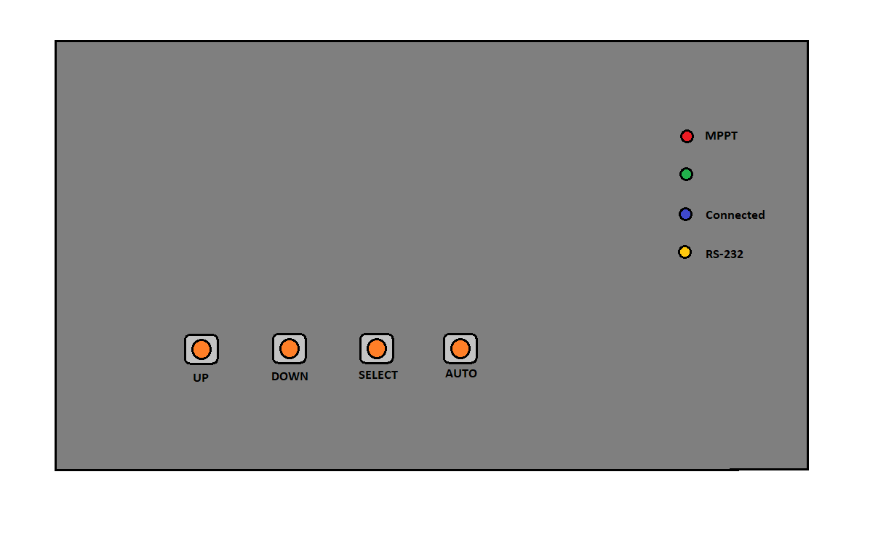
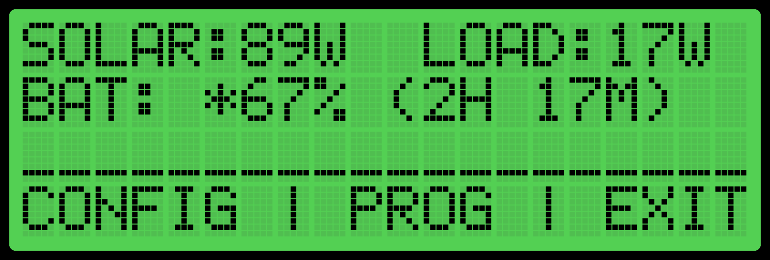
Prototype (#3)
.

